Slide 1
IOT Smart Hospital
02
03
01
CSE457- Mobile & Wireless Networks
04
05

Slide 2
Table of contents
01
02
03
04
05
Network Topology
Hospital Interior
Departments
Patient Smart Room
Prototype

Slide 3
But First… Who are we?
Youssef El Nagy 20P8842
Juliana Emad 20P3292
Omar Ashraf 20P1542
Youssef Mohamed 20P2810

Slide 4
01
Network Topology

Slide 5
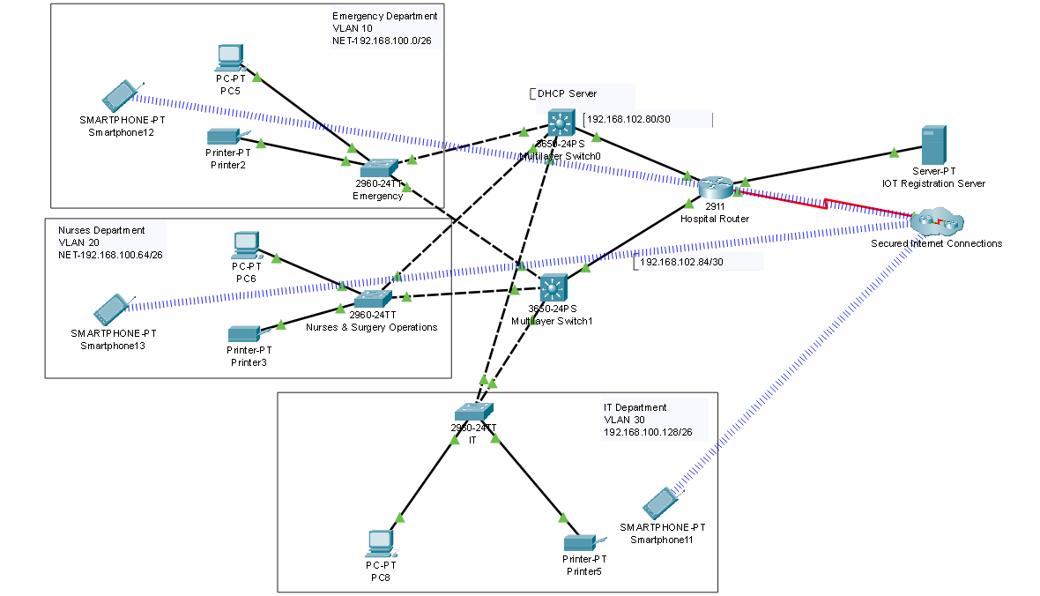
Network Topology

Slide 6
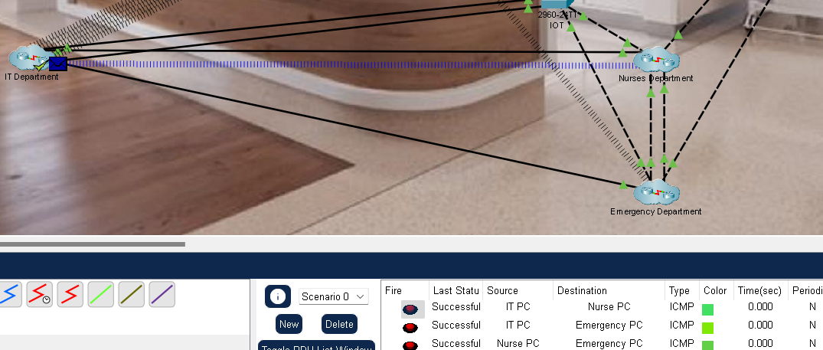
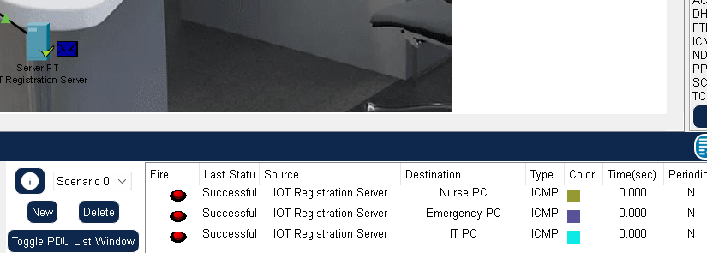
Pinging Devices Across Network
Communication between all department end devices:
IT -> Nursing
IT -> Emergency
Nursing -> Emergency
Communication between all department end devices & IoT Registration Server

Slide 7
02
Hospital Interior

Slide 8
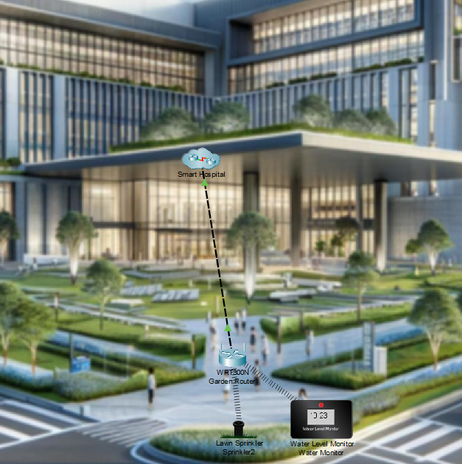
Smart Garden

Slide 9
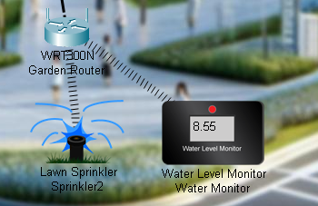
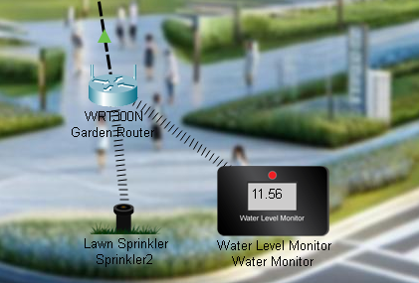
Water Monitor Level <=10
Sprinkler ON
Water Monitor Level >10​
Sprinkler OFF

Slide 10
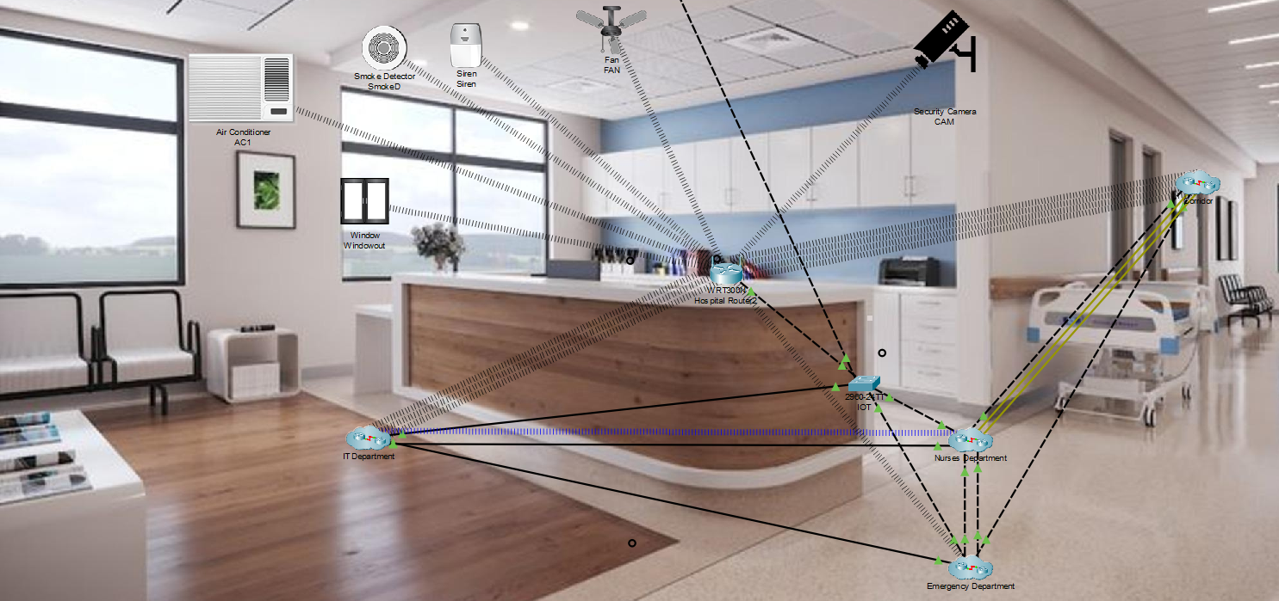
Waiting Room

Slide 11
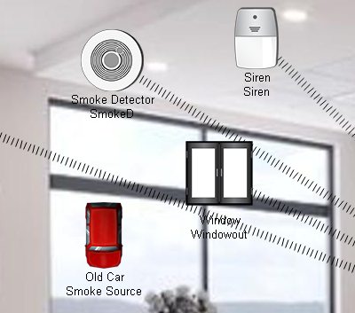
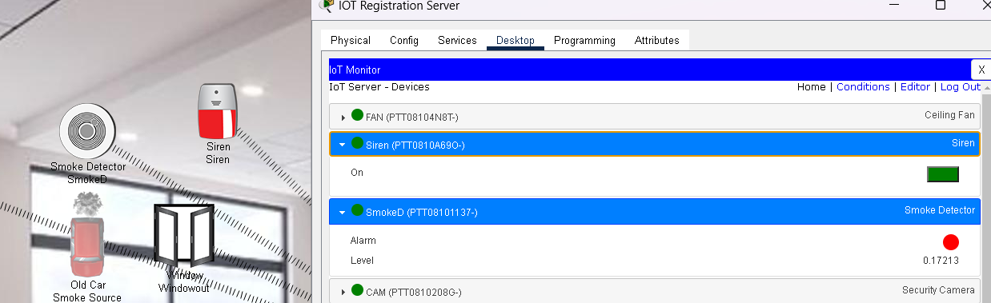
Smoke Detector
SmokeD Level < 0.17​
Set Siren On to OFF
Set Windowout On to OFF
Old Car is used as a Smoke Source
SmokeD Level >= 0.17
Set Siren On to true
Set Windowout On to true

Slide 12
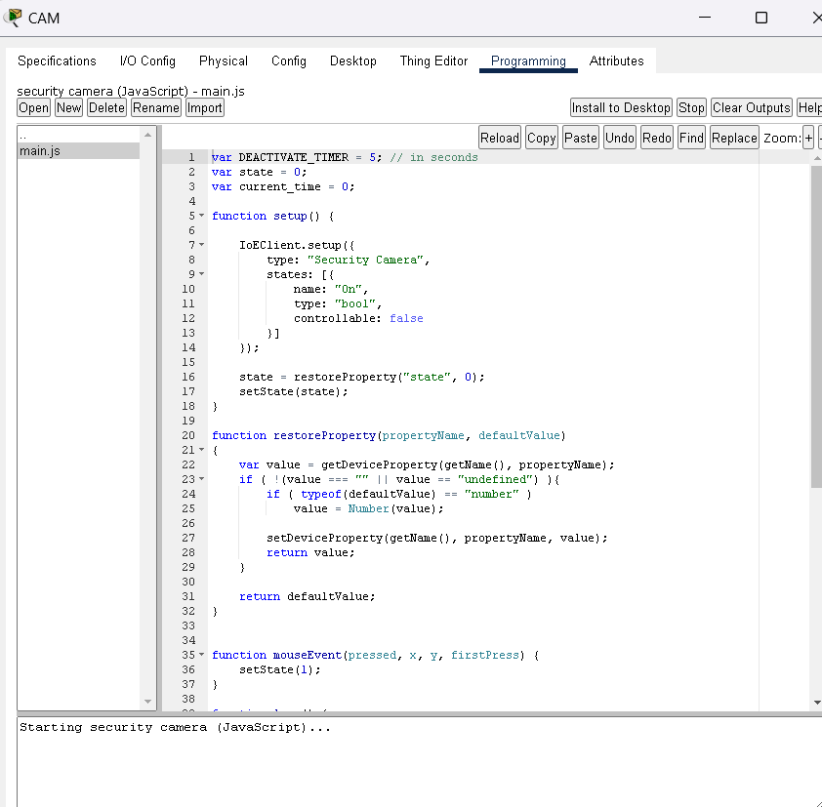
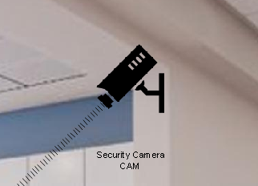
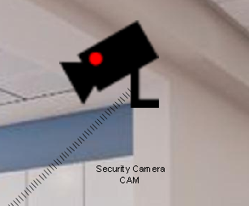
Creating an IOT Thing
Security Camera
Motion Detector code is used to detect any motion in Security Camera
Camera OFF
Camera ON

Slide 13
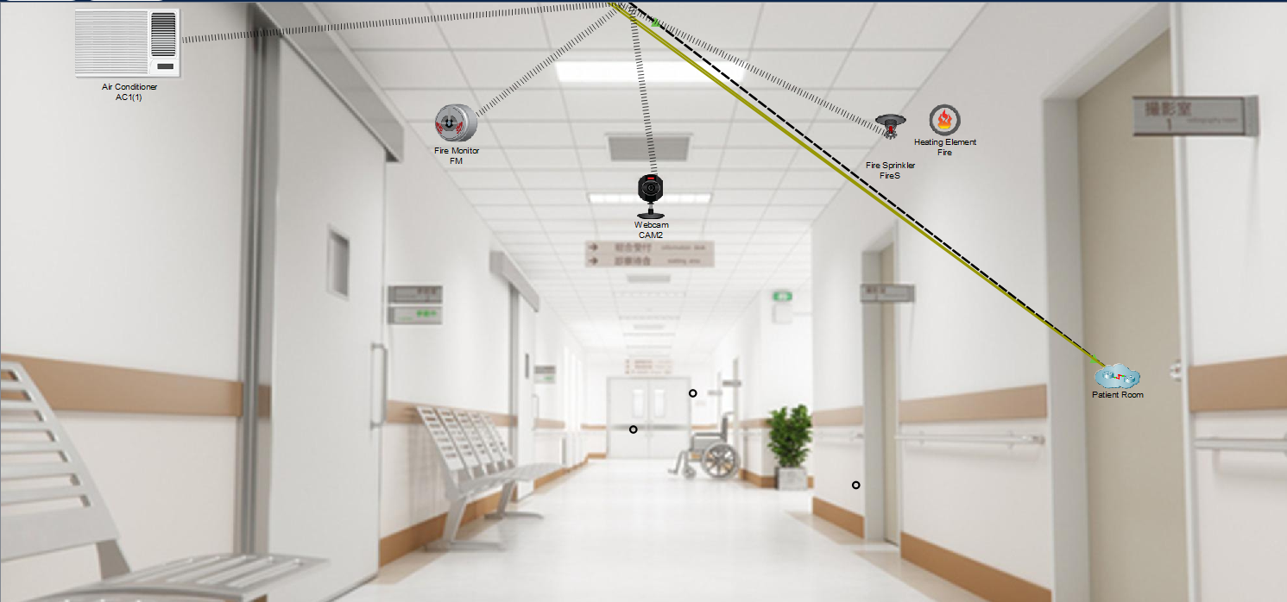
Corridor

Slide 14
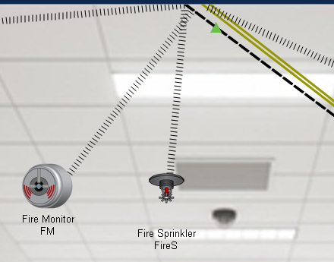
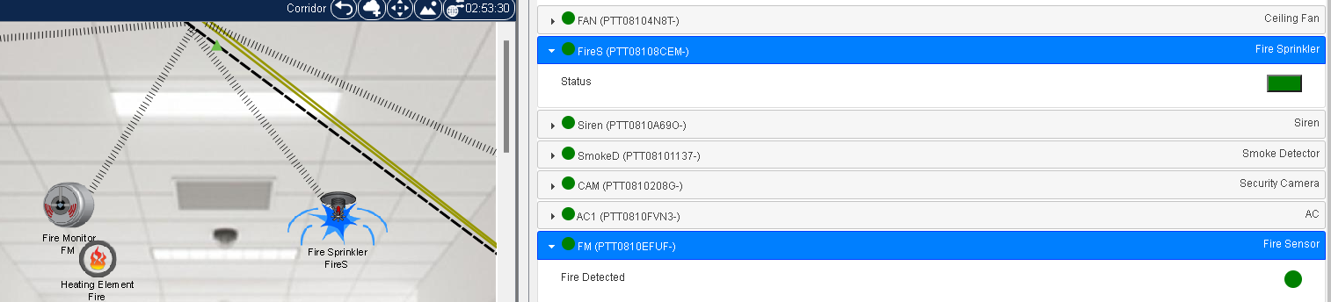
Fire Detection
Fire Monitor will detect any heat & Sprinkler will turn ON when FM detect Heat
Heating Element is used as a fire source

Slide 15
03
Departments

Slide 16
Here are three main departments:
IT
Nursing
Emergency
IT infrastructure forms the backbone of a smart hospital, enabling seamless communication, data management, and automation of processes.
Nurses play a central role in patient care, acting as advocates, educators, and coordinators of care delivery,
remote monitoring systems for patient surveillance.
EDs are often the entry point for patients requiring urgent medical attention, making them critical components of any healthcare system which improve the accuracy of triage and diagnosis.

Slide 17
IT Department

Slide 18
IT Department
The IT Department in hospitals is essential for managing information, optimizing operations, and supporting clinical decision-making.
The IT Room Contains:
IOT Registration Server to connect various devices to a network . It manages the registration process, which involves authenticating devices, assigning them unique identifiers, and granting them access to the network or service.
IOT Temperature Monitoring using 2 Components:
Thermostat
Temperature Monitor
Security: RFID for authentication

Slide 19
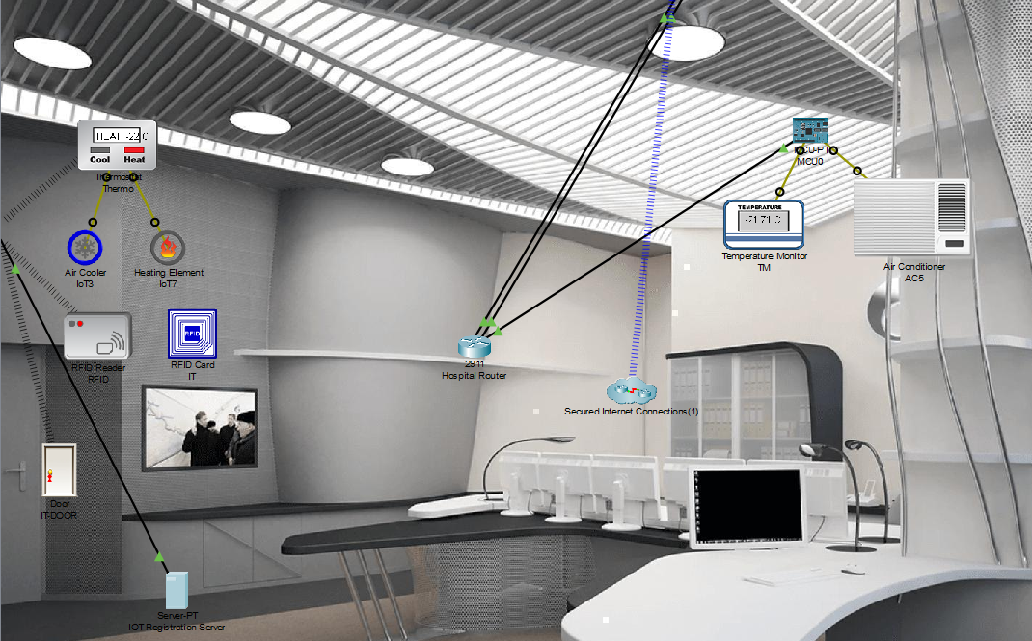
IT Department

Slide 20
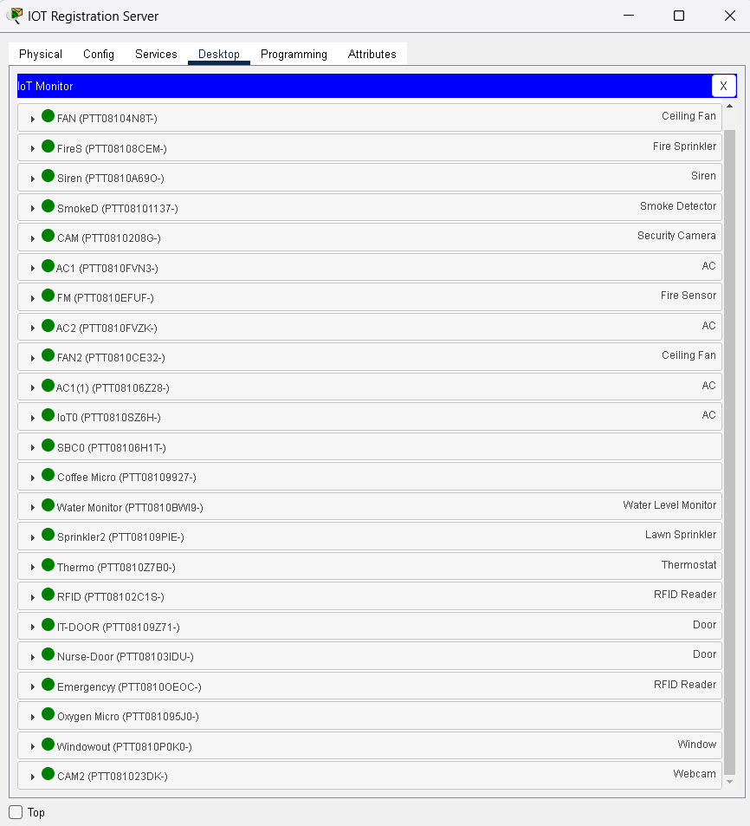
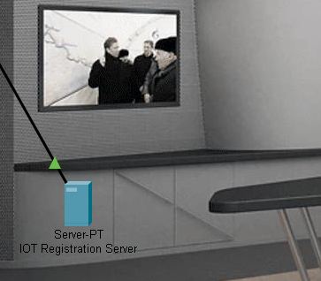
IoT Registration Server

Slide 21
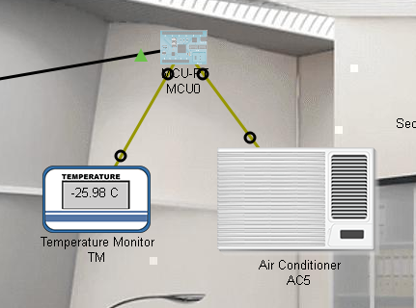
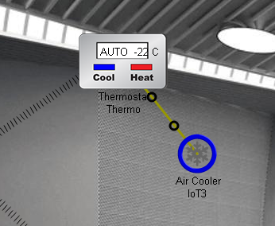
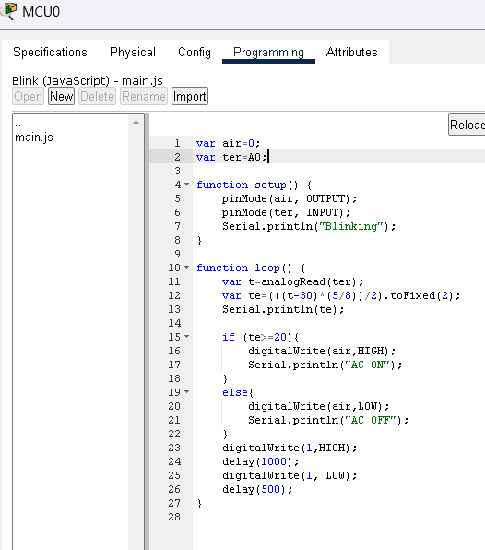
IT Temperature Monitoring
Temp. Monitor
Thermostat
If Temperature>=20
AC will Turn ON
Auto Mode: Air Cooler ON
While If Temperature<20
AC will Turn OFF

Slide 22
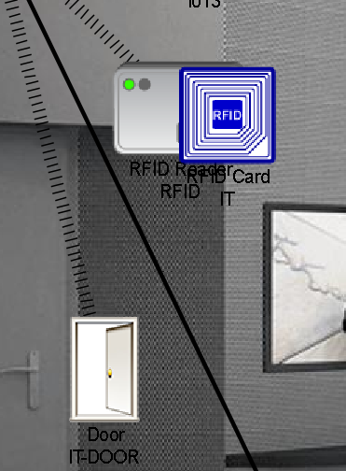
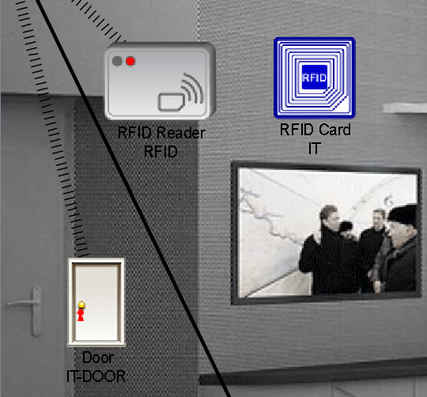
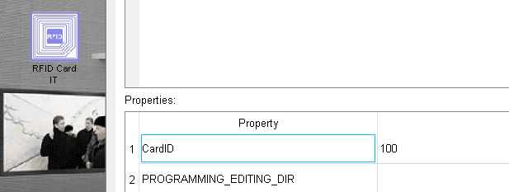
Departments Security RFID (Radio-Frequency Identification)
RFID Reader reads Card ID and turns ON if the ID matches.

Slide 23
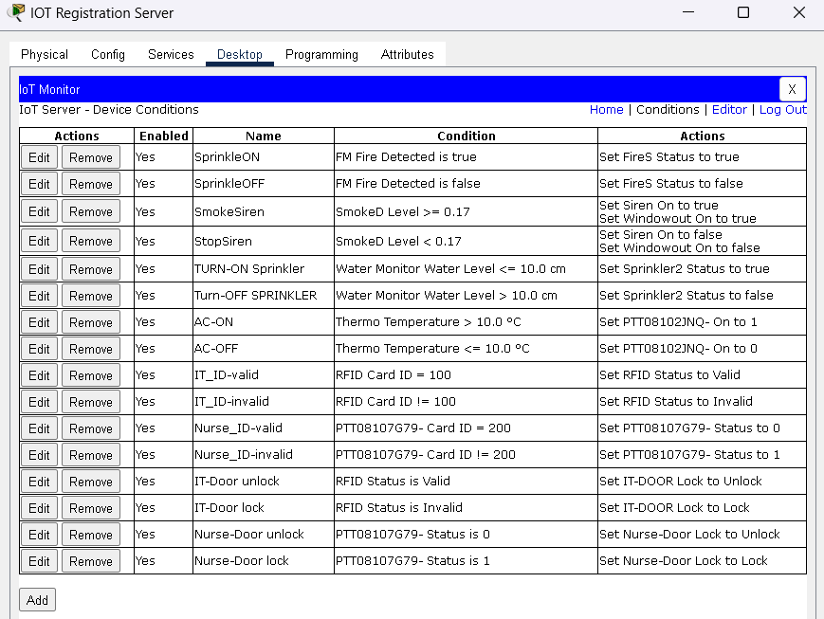
Registration Server Conditions

Slide 24
Nursing Department

Slide 25
Nursing Department
Patient Care: The primary responsibility of the Nursing Department is to provide direct patient care.
Nurses often use PCs to communicate with other healthcare professionals, such as doctors, specialists, or pharmacists, through email, messaging systems, or teleconferencing tools
Also, To access electronic health records (EHRs) or electronic medical records (EMRs) systems to update patient information or other medical data.
Emergency Response: Nurses are trained to respond to medical emergencies and provide immediate care in critical situations through
Alarm if any abnormal readings in Oxygen or Pulse rate of patients.

Slide 26
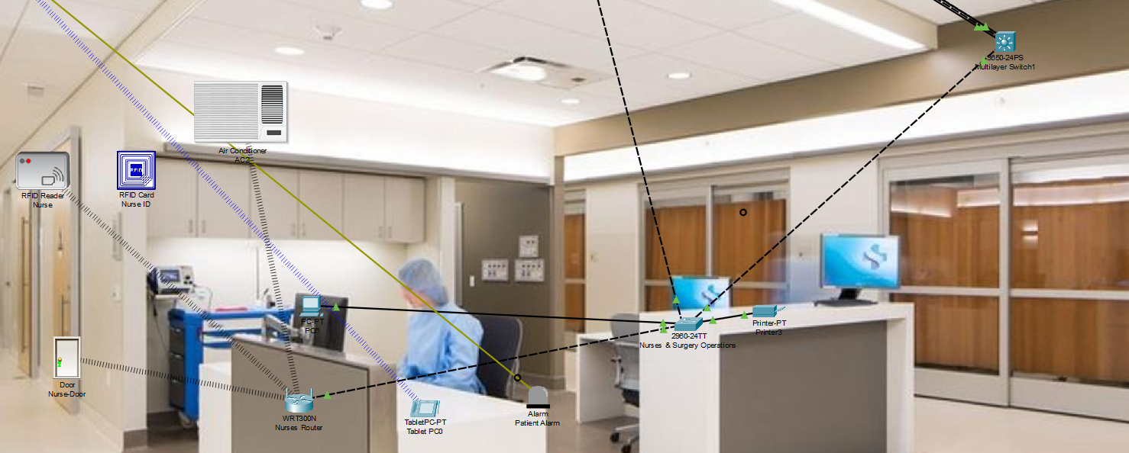
Nursing Department

Slide 27
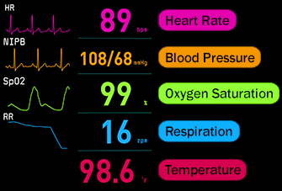
Patient Care

Slide 28
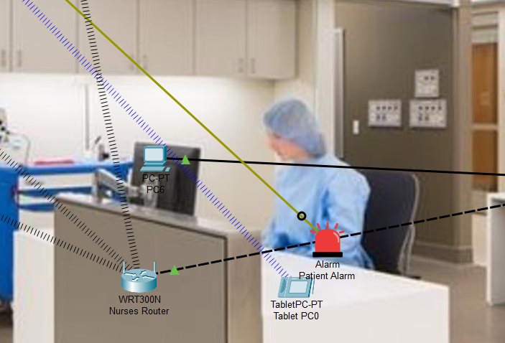
Patient Care
Nurses are notified when patients are in crisis through the alarms connected to the rooms.

Slide 29
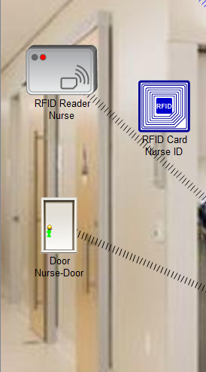
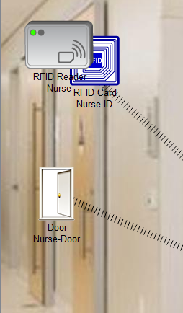
Nursing Department Security
RFID reader reads ID and automatically opens the door for nurses with access only.
Door opens when a valid ID is read

Slide 30
Emergency Department

Slide 31
Emergency Department
Urgent Care: The primary function of the Emergency Department is to provide urgent medical care to patients experiencing severe or life-threatening conditions. This includes medical emergencies such as heart attacks, strokes, traumatic injuries, severe infections, and respiratory distress.
Triage: Upon arrival, patients are triaged by healthcare professionals to prioritize care based on the severity of their condition. Triage ensures that patients with the most critical needs receive immediate attention while others are treated in order of urgency.

Slide 32
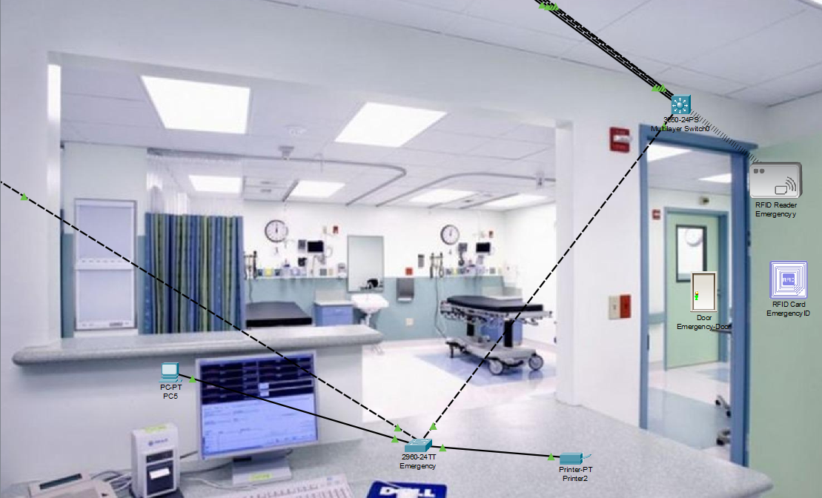
Emergency Department

Slide 33
04
Patient Smart Room

Slide 34
Patient Smart Room
The rooms is integrated with the hospital system for seamless patient care
Vitals monitoring devices are configured:
O2 Monitor
Pulse Rate Monitor
Body Temperature Sensor
Air conditioning is also installed for adjustments based on room temperature and patient comfort
Smart door is configured to allow authorized access
Alerts can be sent to medical staff for abnormal readings or emergencies

Slide 35
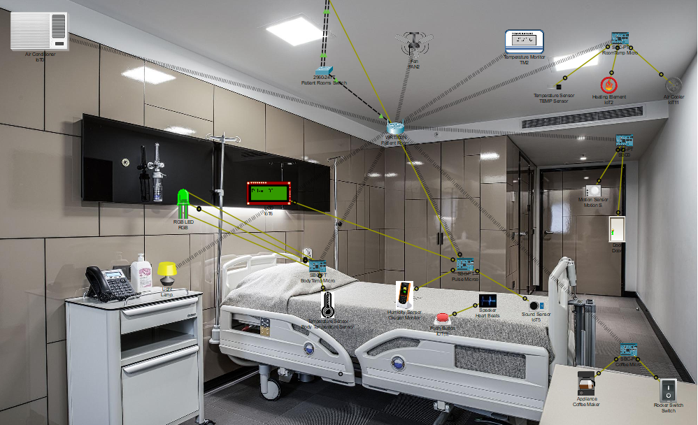
Patient Smart Room

Slide 36
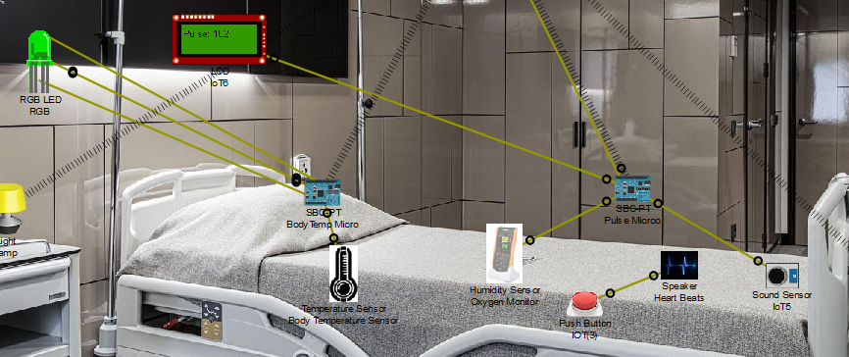
Patient Monitoring System

Slide 37
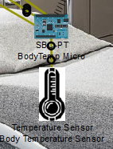
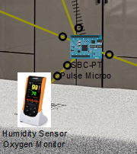
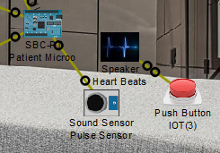
Patient Devices
Body Temperature Sensor
Oxygen Monitor
Pulse Monitor

Slide 38
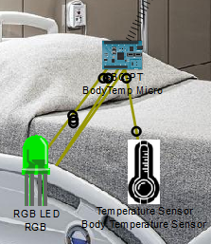
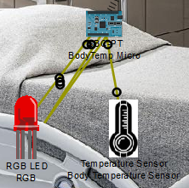
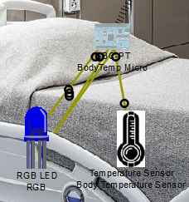
Body Temperature Sensor
Normal Range
Above Threshold
Below Threshold

Slide 39
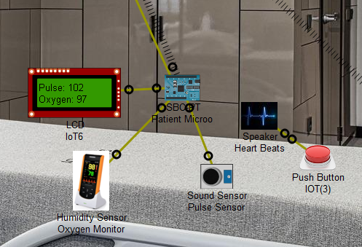
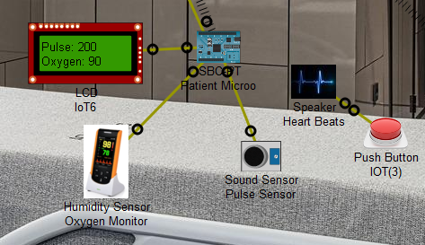
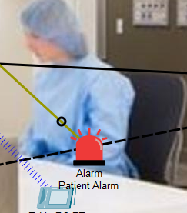
Oxygen + Pulse Rate Monitors
Normal Readings
Abnormal Readings trigger alarms to alert nurses

Slide 40
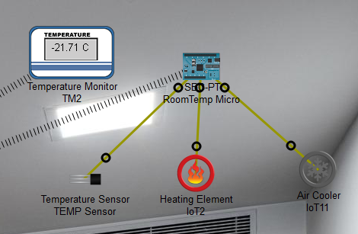
Room Temperature Controls

Slide 41
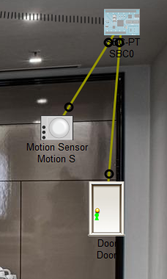
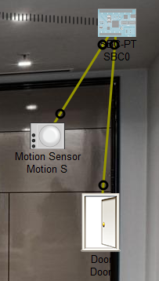
Smart Door
Smart Door automatically opens if motion detector senses nearby motion

Slide 42
5
Prototype

Slide 43
Thanks!
Do you have any questions?

